Slide 1
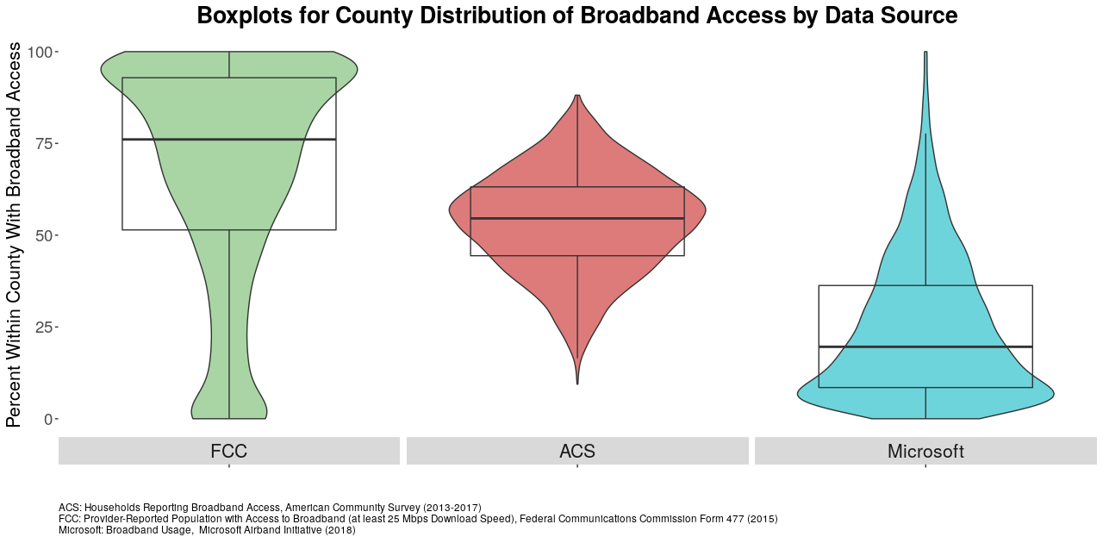

Slide 2
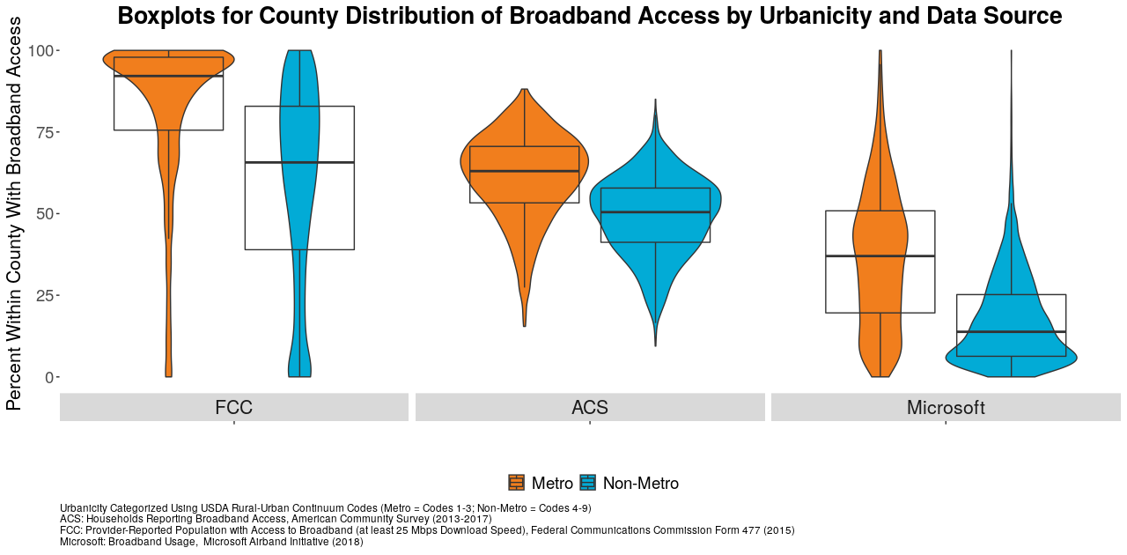

Slide 3
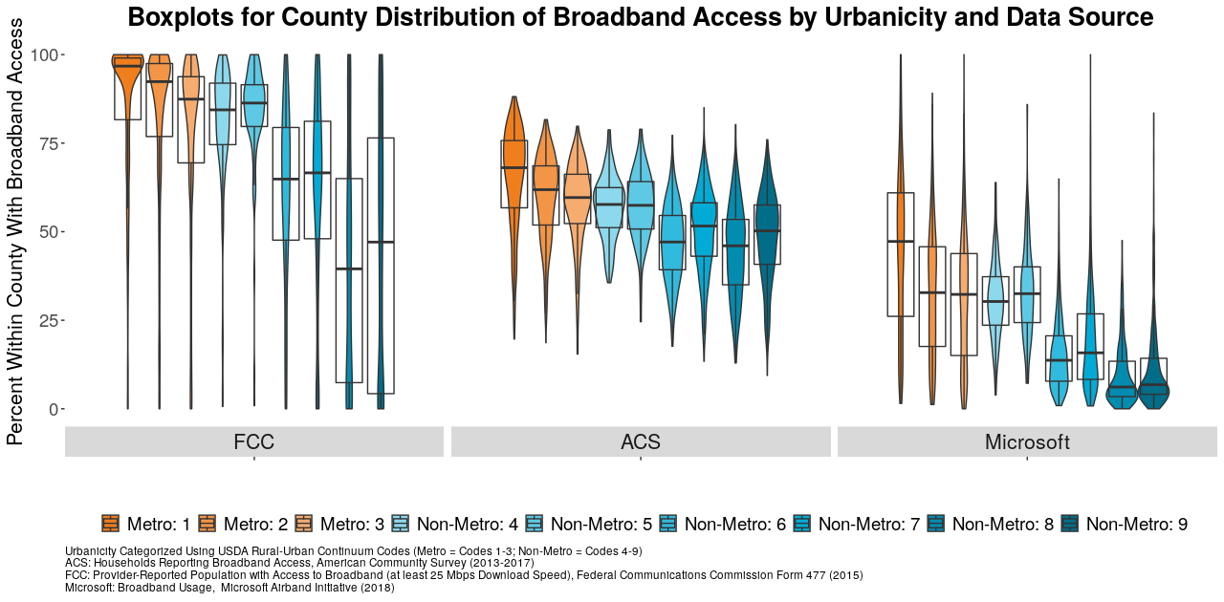

Slide 4
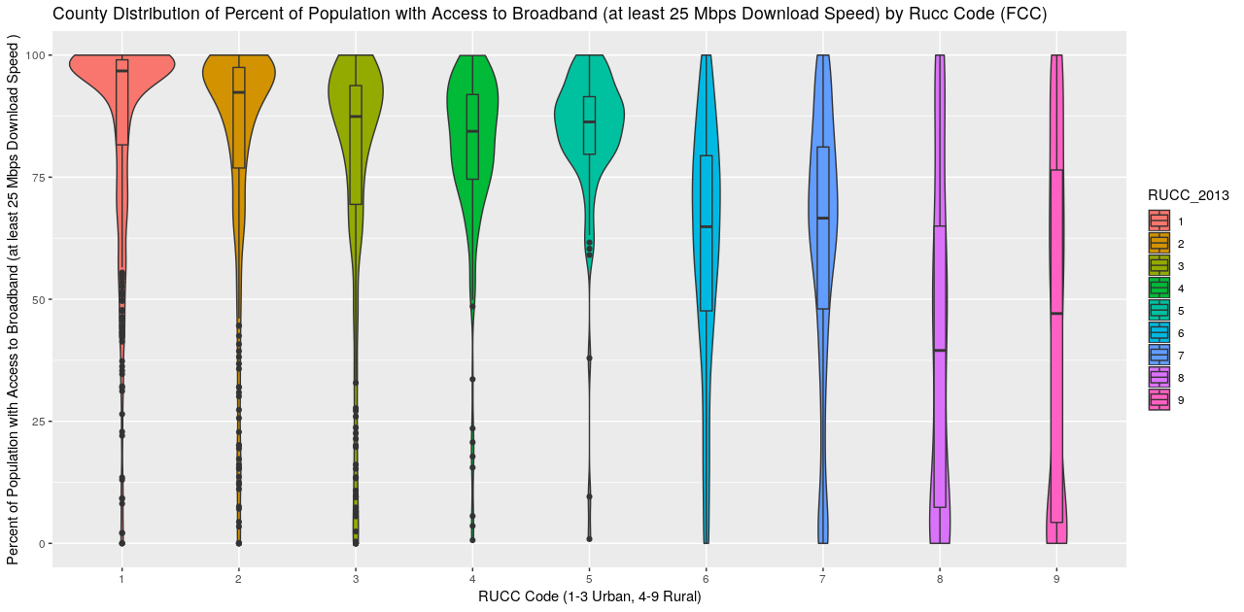
Not for poster

Slide 5
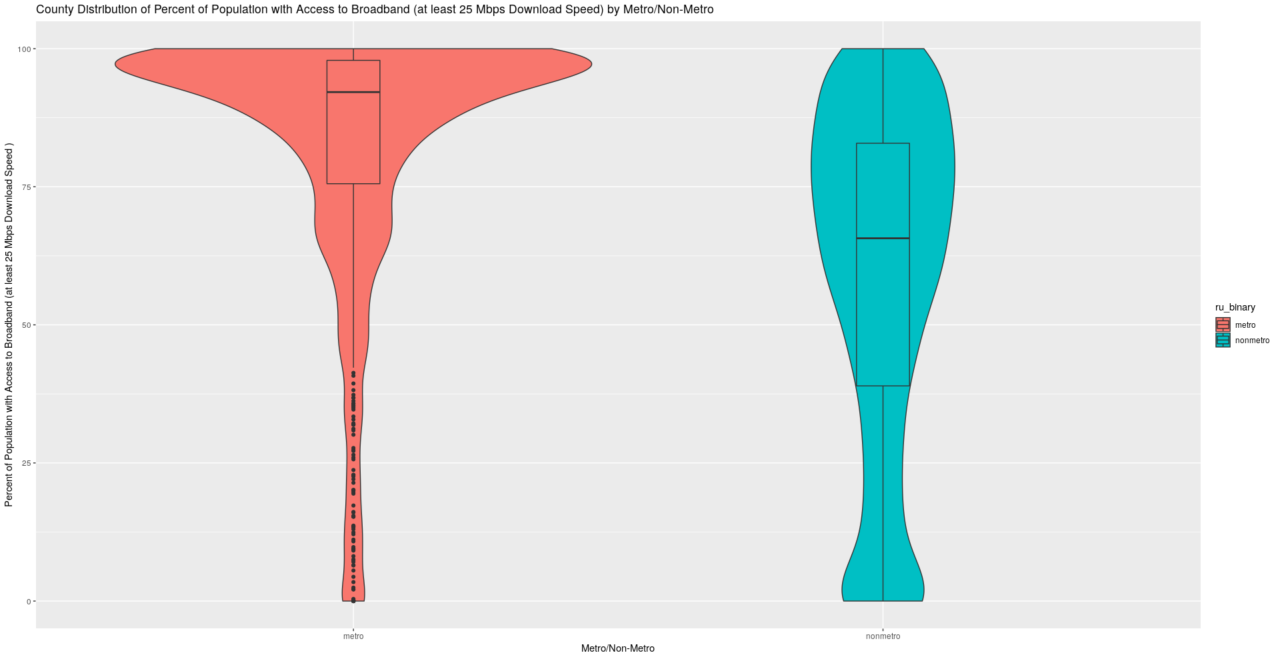
I assume that plots on slides 2, 4, and 6 are showing the same thing but are from different data sources (I get you were only doing this as a proof of concept!)
Can we come up with a way to display Microsoft, FCC, and ACS % access by metro/nonmetro? That is, the same thing as Slide9, but with urbanicity (so two distributions for each source).
You could do plot slide9 again but facet by metro/nonmetro, or if all else fails, there are always gridExtra and ggarrange.
Updated annotations for the plot should be:
Title: County Distribution of Broadband Access by Urbanicity and Data Source
Y label: Percent with broadband access
X label: (this will depend on how you are showing things – either Urban Status or data source or both)
Notes: Urbanicity categorized using USDA Rural-Urban Continuum Codes (metro = codes X-Y; non-metro = codes W-Q).
FCC = Federal Communications Commission Form 477, 2015. ACS = American Community Survey table XXXXX, 2013-17 5-year estimates. Microsoft: Microsoft
Airband Initiative, 2018.
Measures shown: ACS: Percent consumers reporting broadband access.
FCC: Percent providers reporting ….
Microsoft: Percent consumers accessing Microsoft services using broadband speeds.

Slide 6
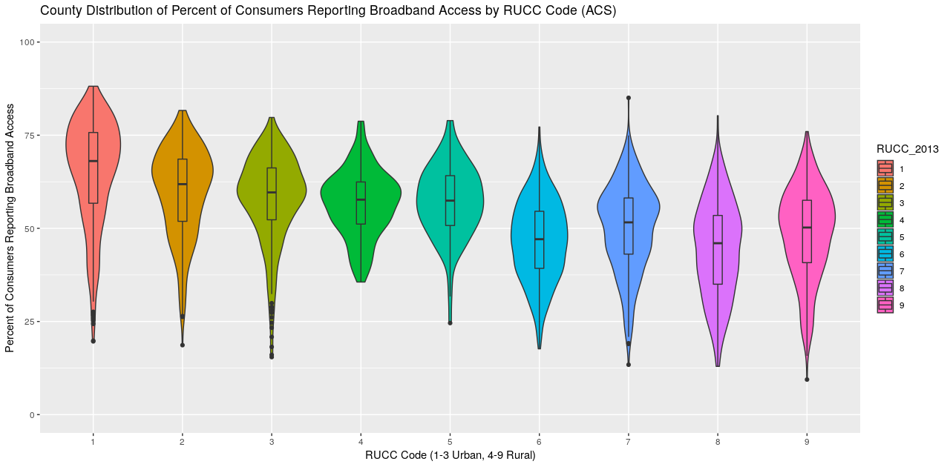
Not for poster

Slide 7
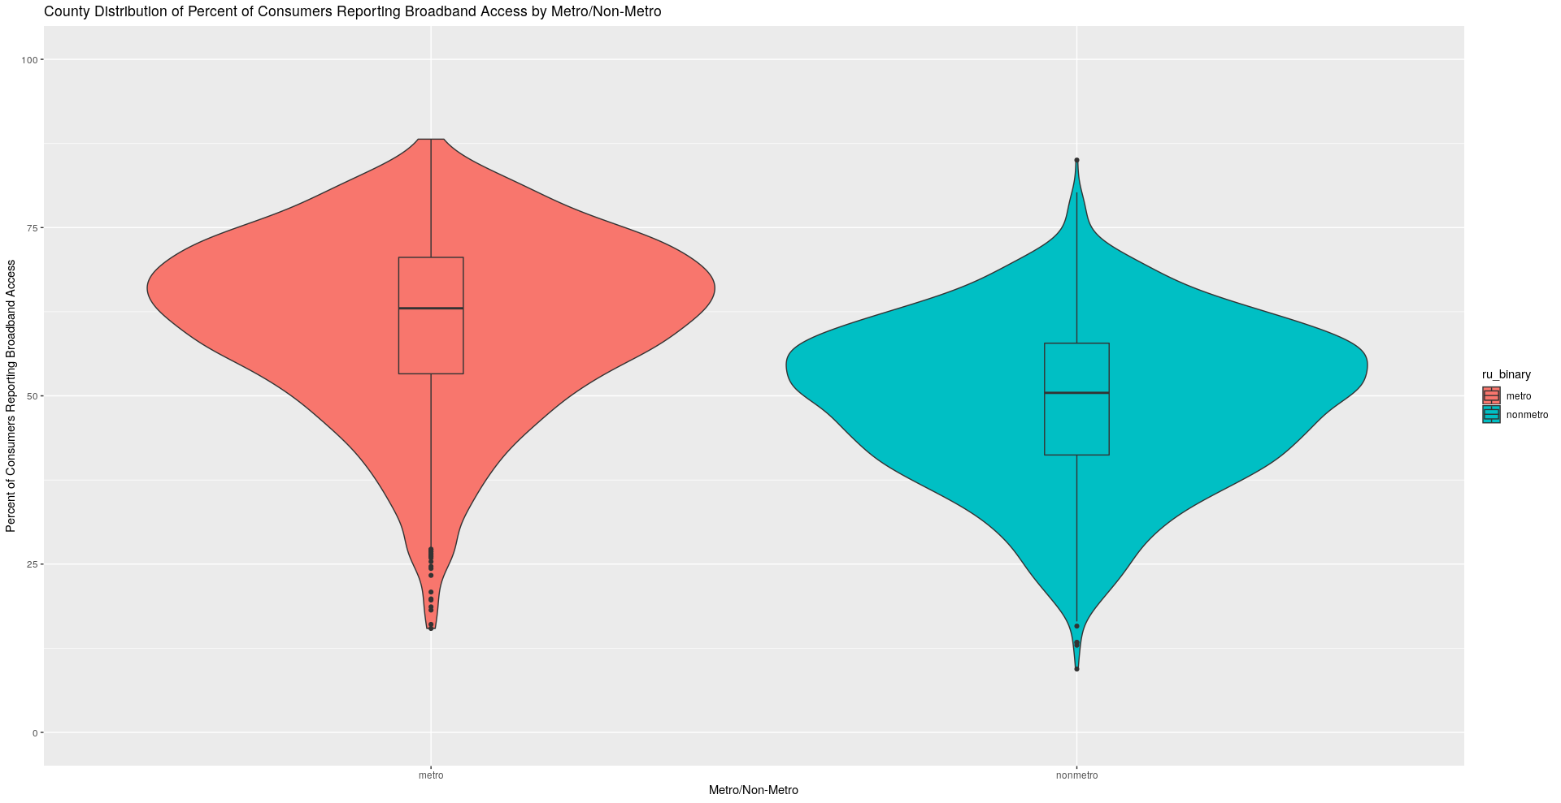
See slide 2

Slide 8
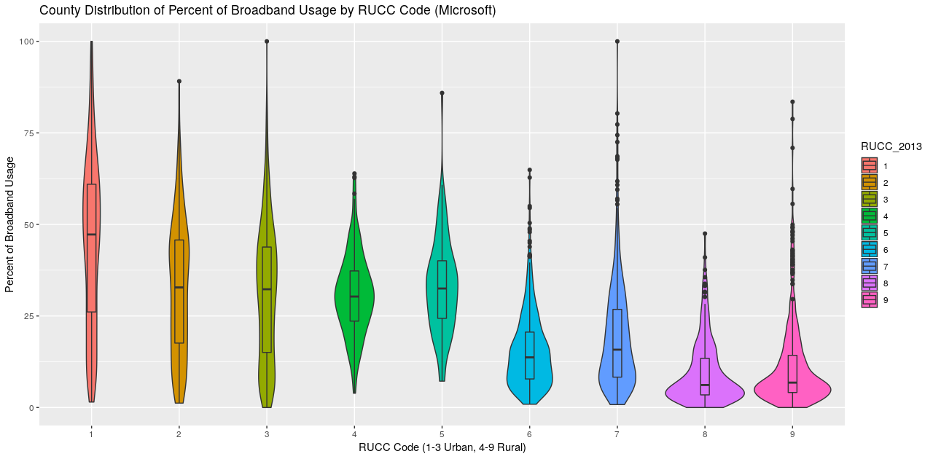
Not for poster

Slide 9
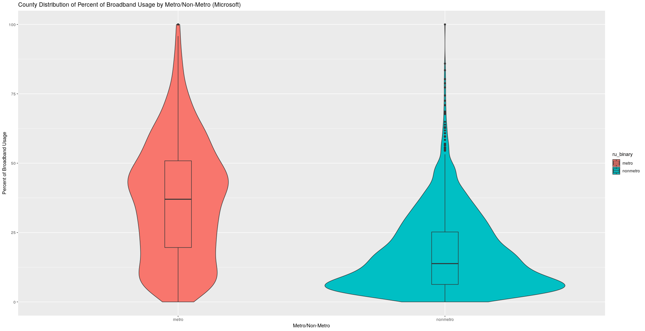
See slide 2

Slide 10
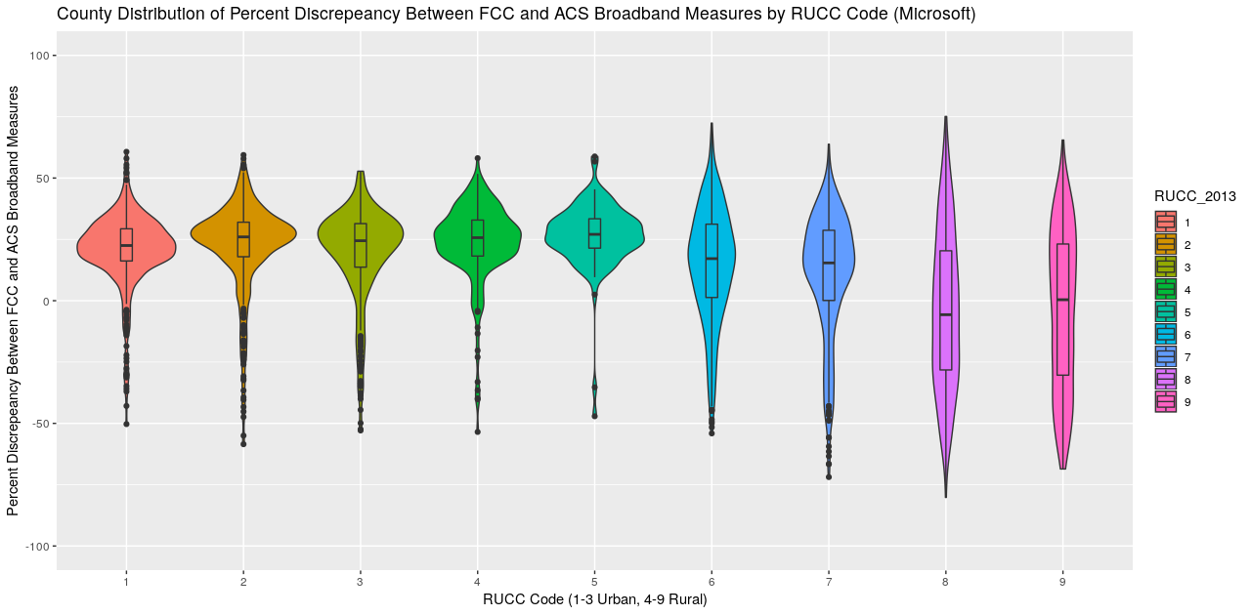
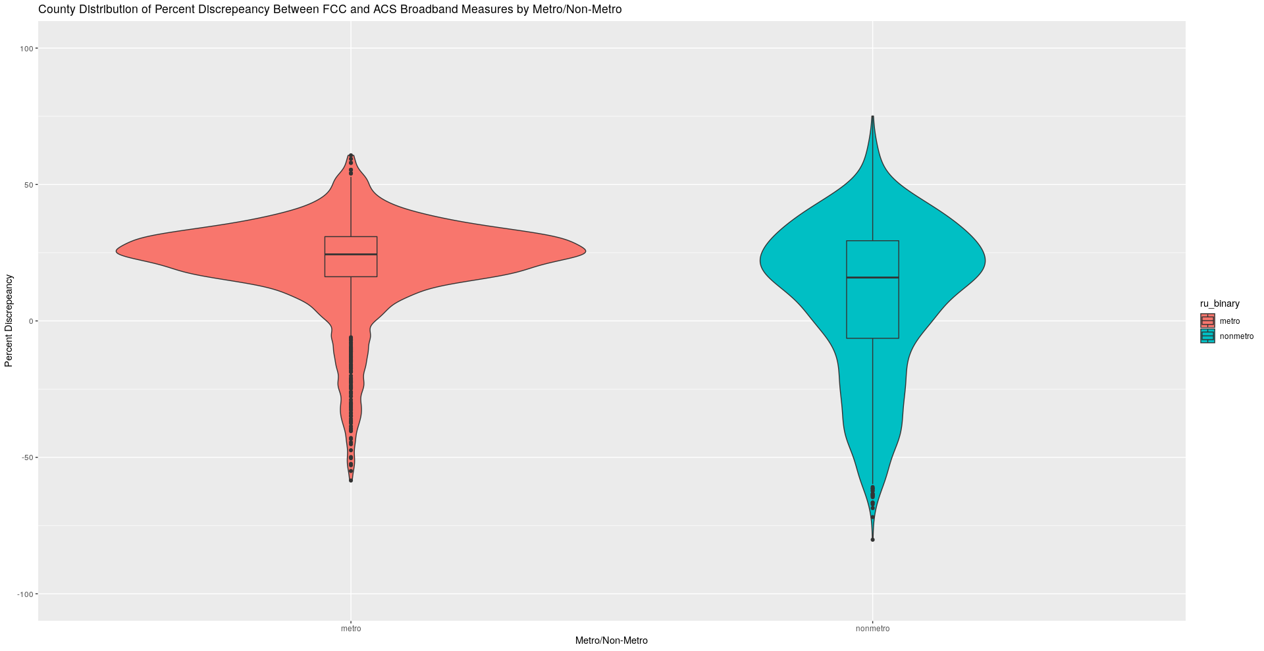
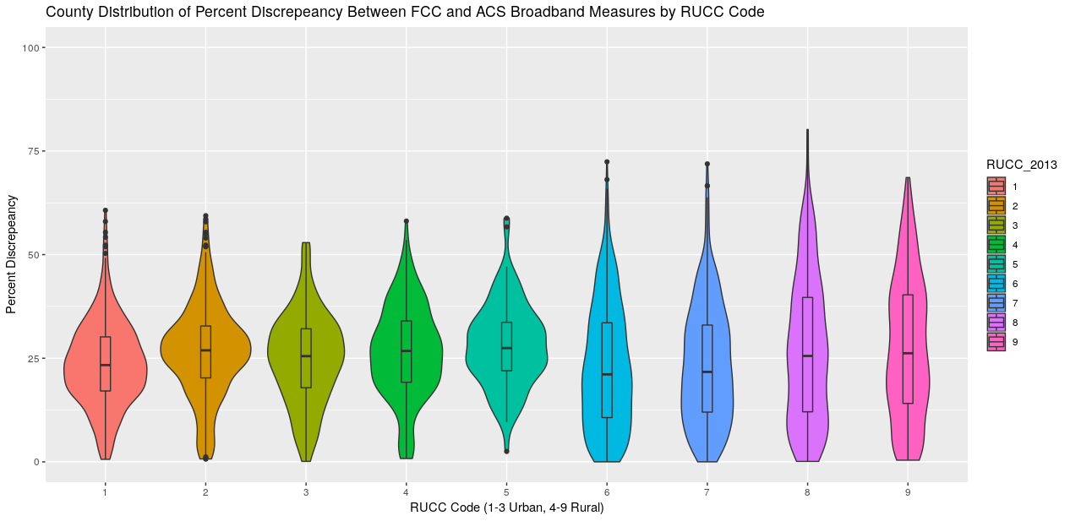
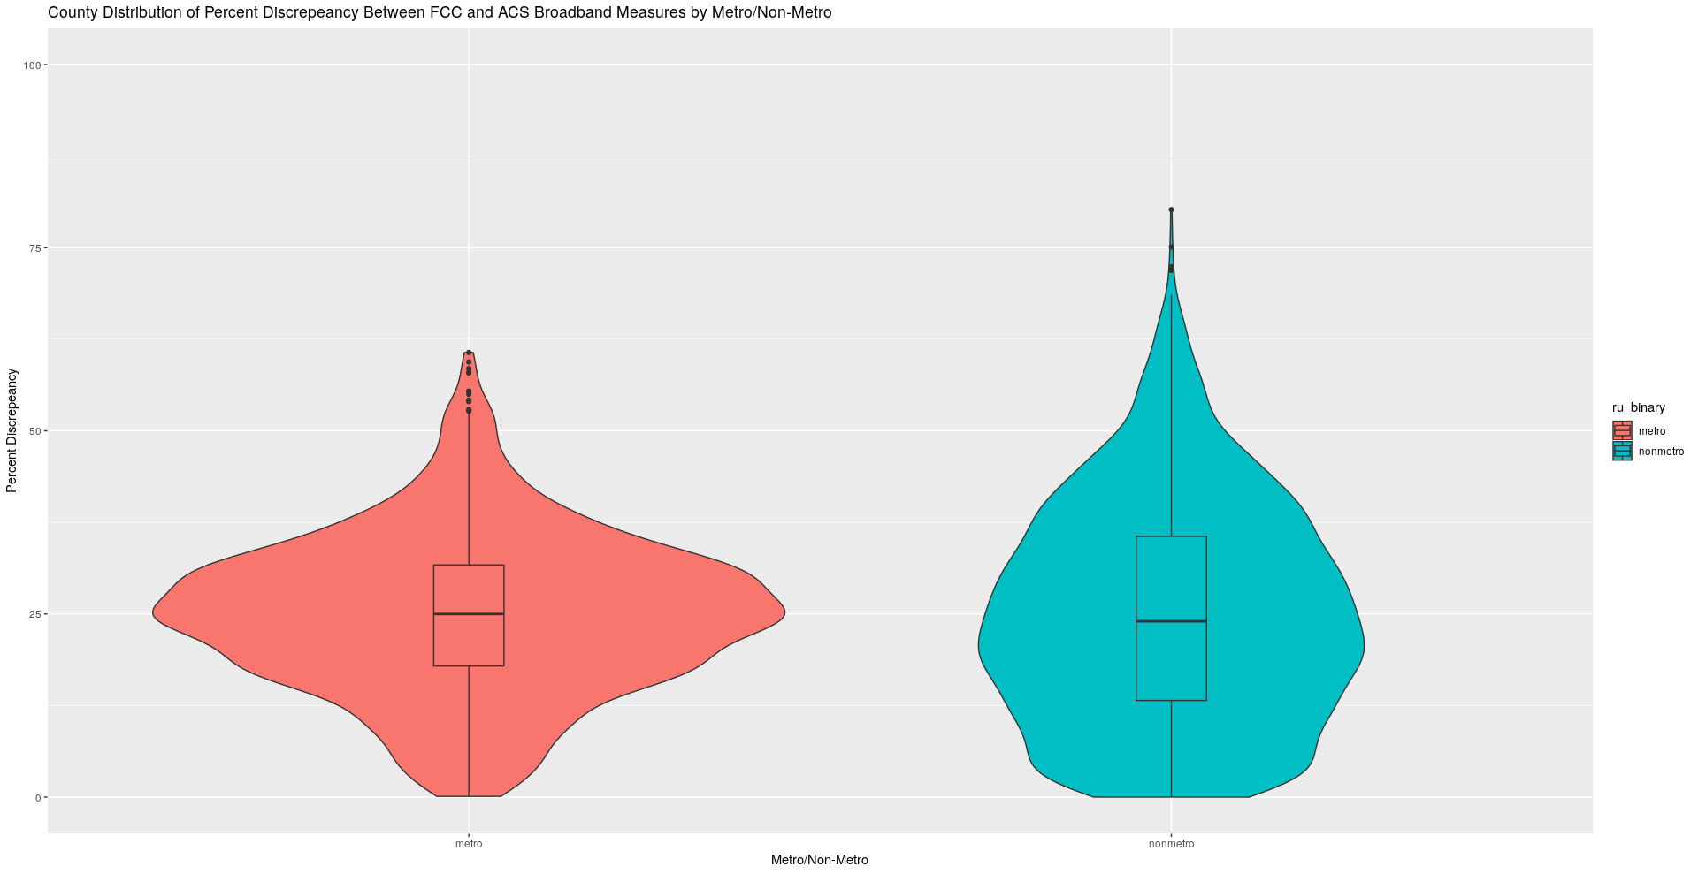
Discrepancy (top) & Absolute Discrepancy (Bottom)
The graphs following this slide use absolute discrepancy as the discrepancy measure

Slide 11
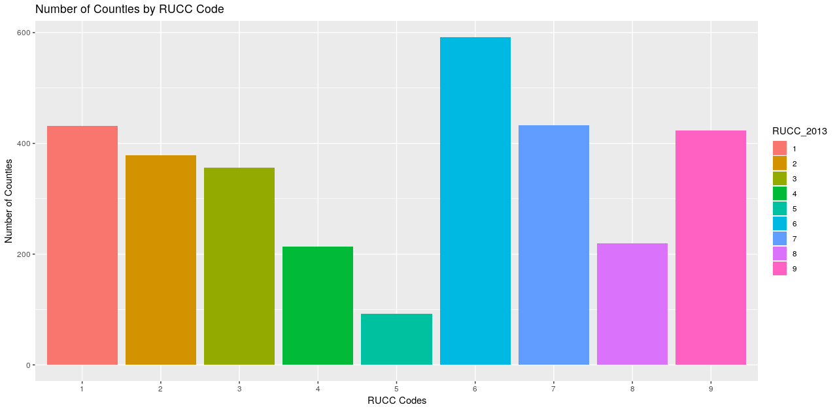
Not for poster

Slide 12
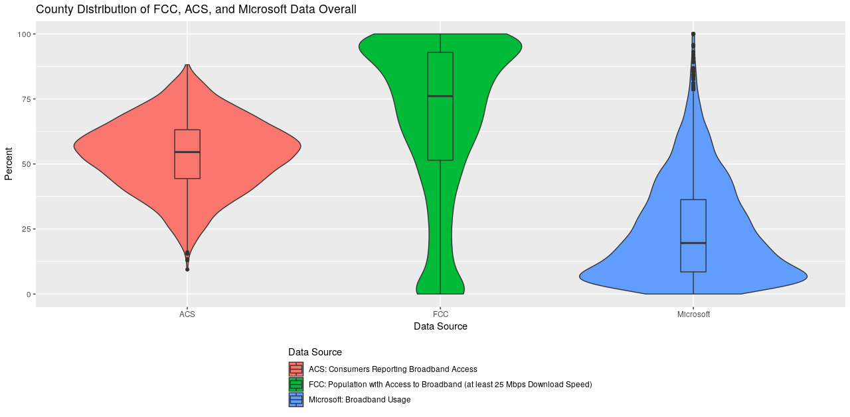
T: I think we definitely want this one, but with a better title/labels and reordered highest-lowest (or vice versa)
Title: County Distribution of Broadband Access by Data Source
Y label: Percent with broadband access
X label: Data source
Notes: FCC = Federal Communications Commission Form 477, 2015. ACS = American Community Survey table XXXXX, 2013-17 5-year estimates. Microsoft: Microsoft Airband Initiative, 2018.
Measures shown: ACS: Percent consumers reporting broadband access.
FCC: Percent providers reporting ….
Microsoft: Percent consumers accessing Microsoft services using broadband speeds.

Slide 13
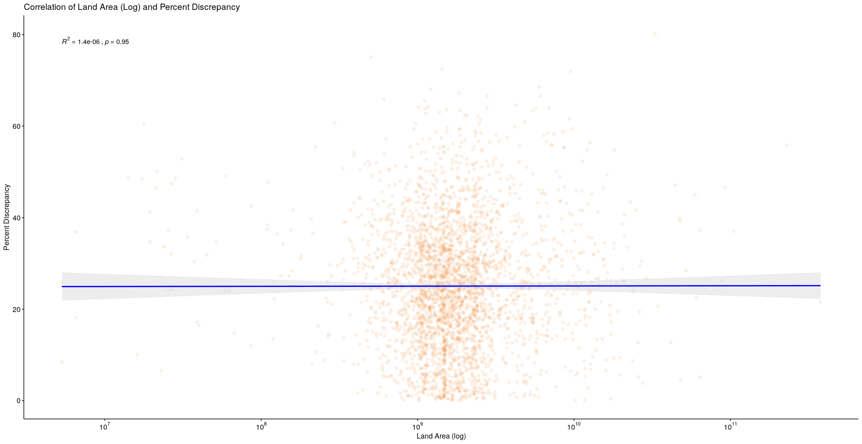
Not for poster

Slide 14
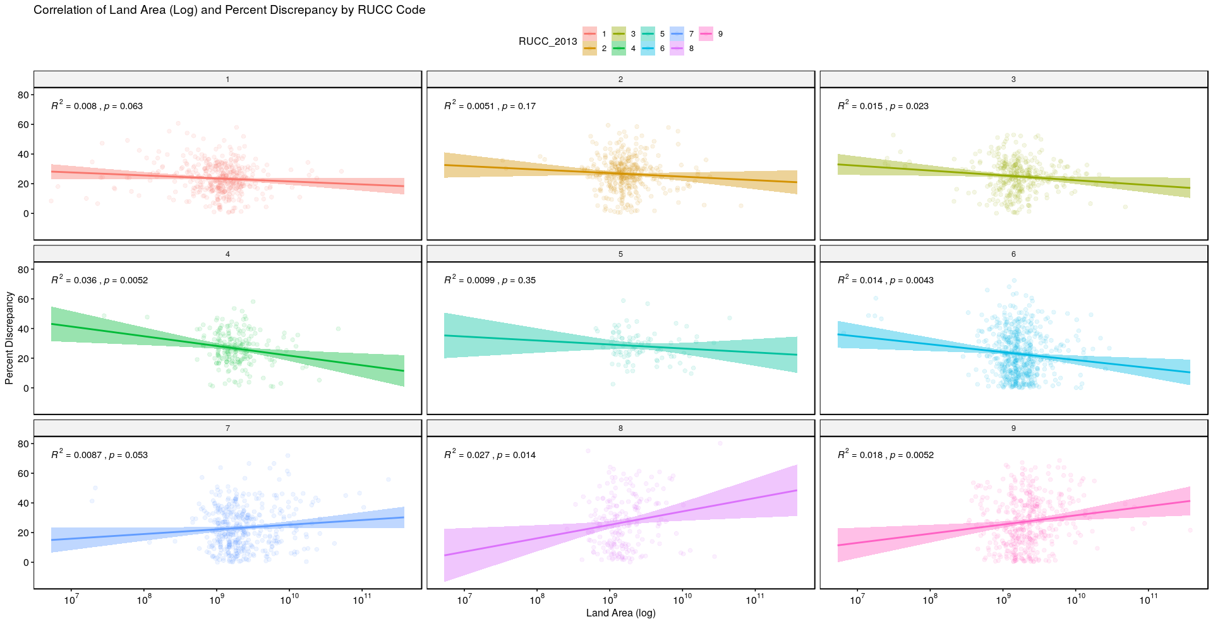
Not for poster

Slide 15
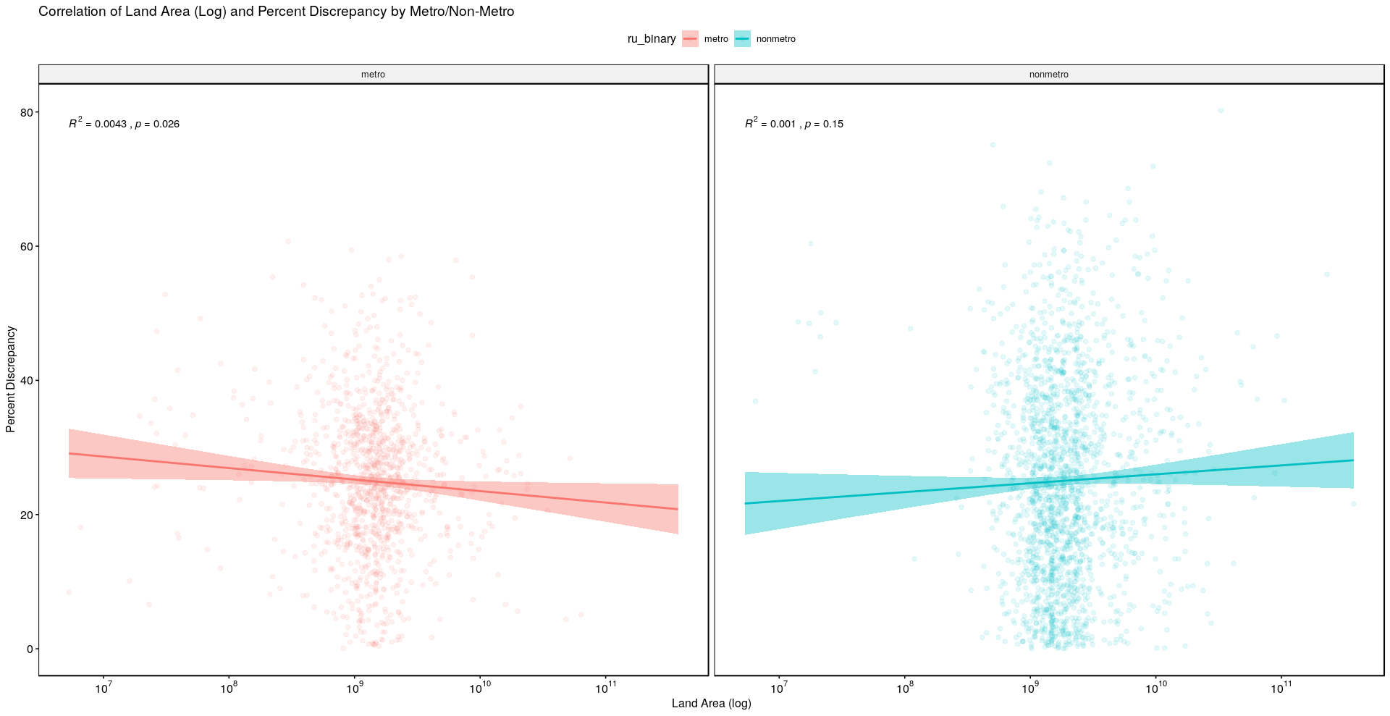
Not for poster

Slide 16
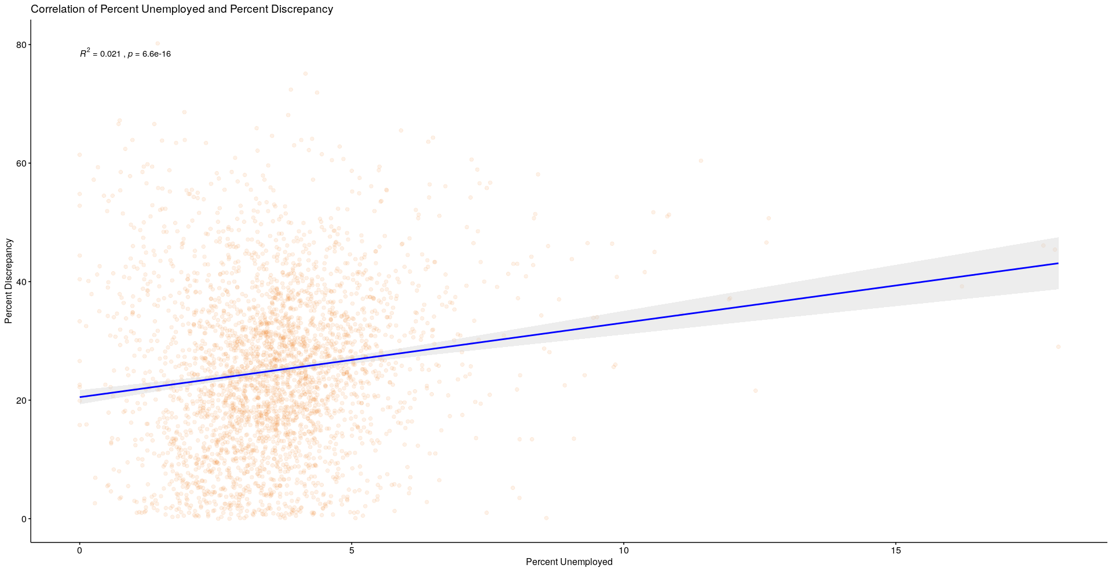
Not for poster

Slide 17
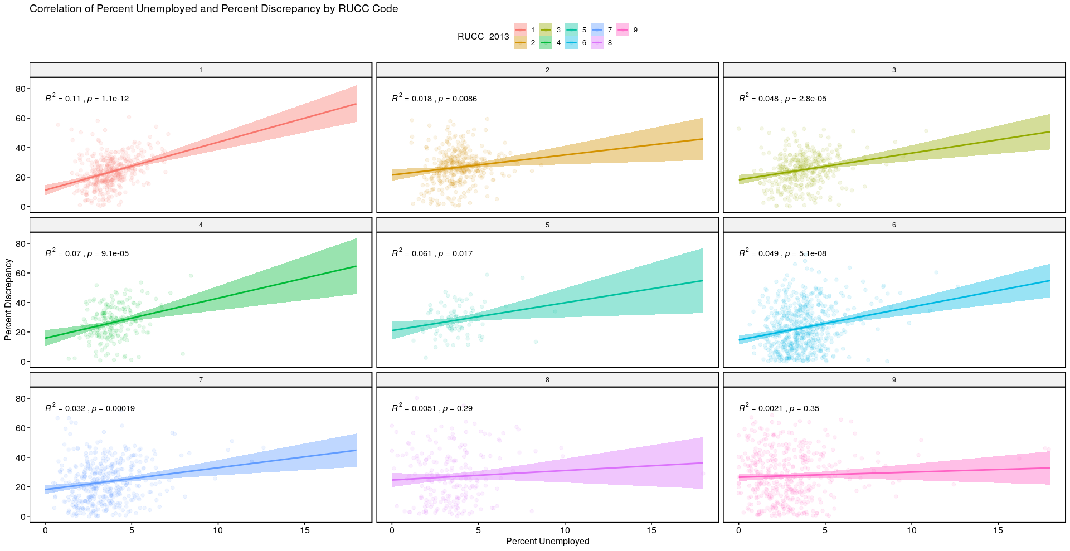
Not for poster

Slide 18
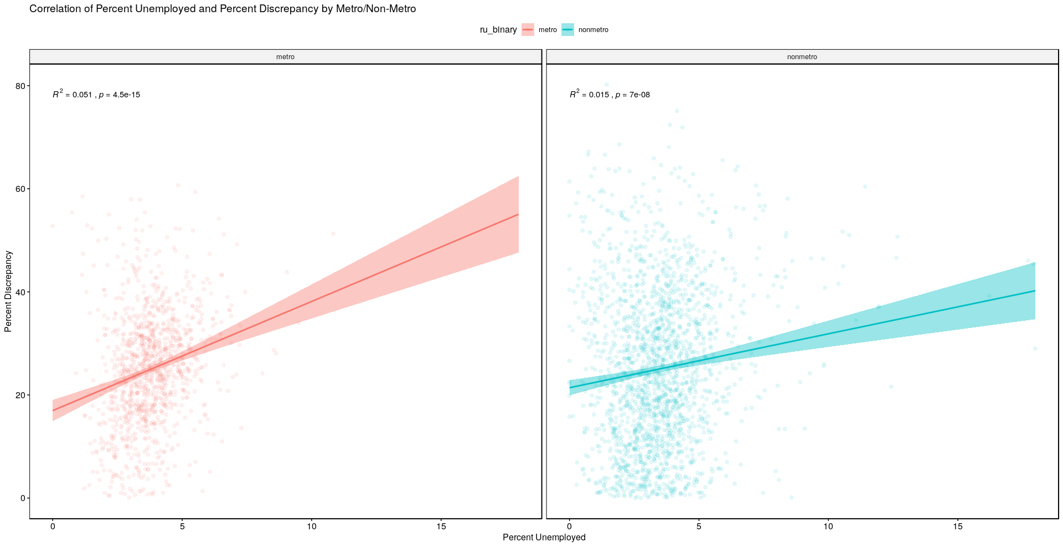
I think we should have a section for a potential association between SES and broadband access/discrepancies and display this along with Slide 21 (minority population), Slide24 (in poverty) and Slide27 (no high school). We haven't had time to really explore this :( but it's a good next step and these three plots suggest there might be something going on (with a huge asterisk on that we haven't done any analyses on this).
I suggest stacking these plots one after another (metro always on the left side, nonmetro always on the right). Make sure the Y axis is always on the same scale for all three plots (x axis can vary).
Updated plot labels, for all three plots (variables will vary):
Correlation of XXXX and Percent Broadband Access Discrepancy by Urbanicity
Left panel: Metro area
Right panel: Nonmetro area
Y axis: Percent broadband access discrepancy
X axis: Variable name (percent population unemployed, percent population in poverty, percent...)
Notes under: Urbanicity categorized using USDA Rural-Urban Continuum Codes (metro = codes X-Y; nonmetro = codes W-Q).
The discrepancy measure represents the absolute difference between percent ??Federal Communications Commission Form 477 provider-reported.... and percent American Community Survey Table XXX consumer-reported broadband access.

Slide 19
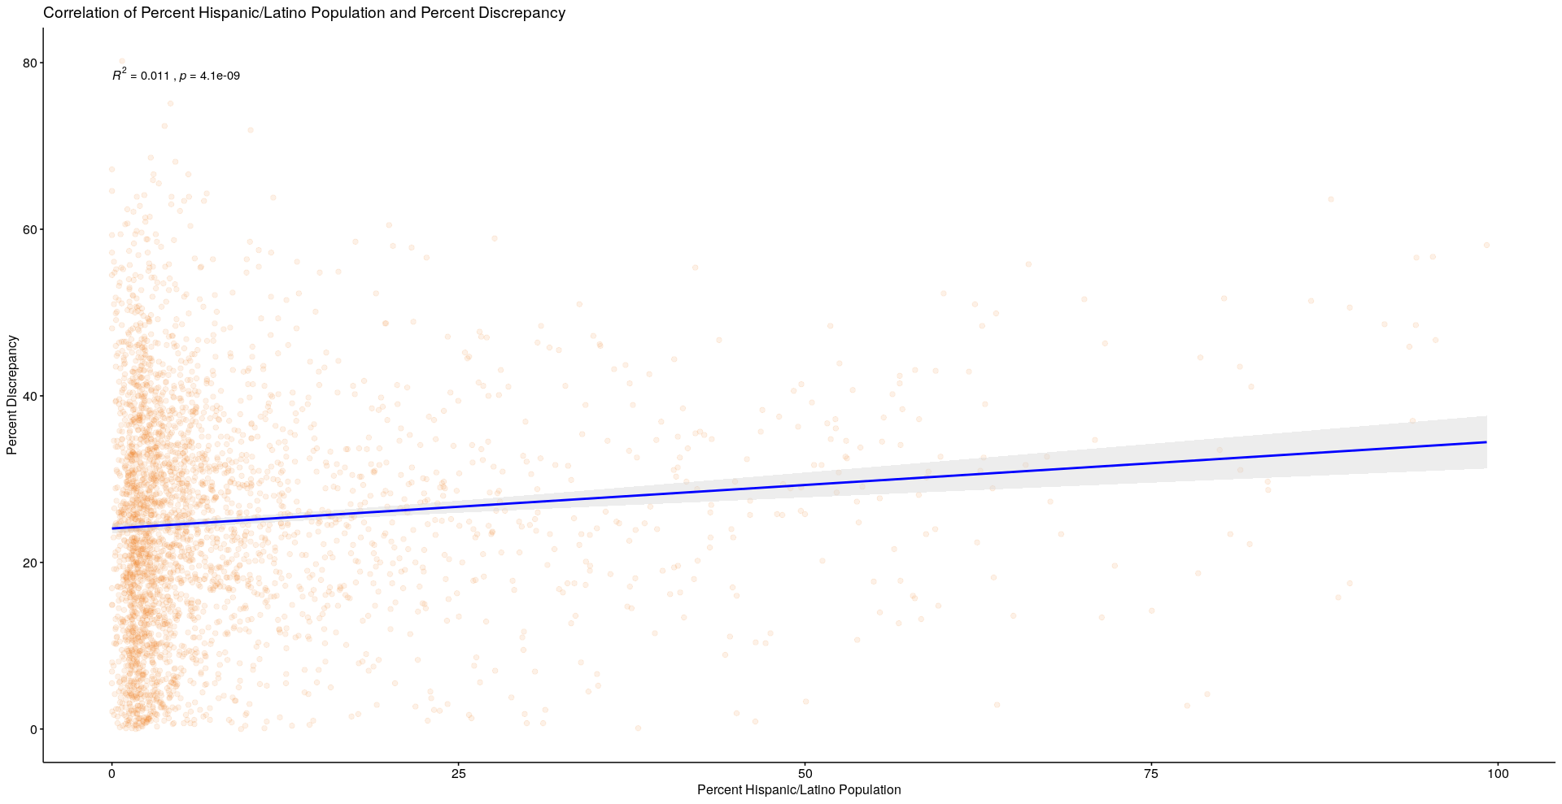
Not for poster

Slide 20
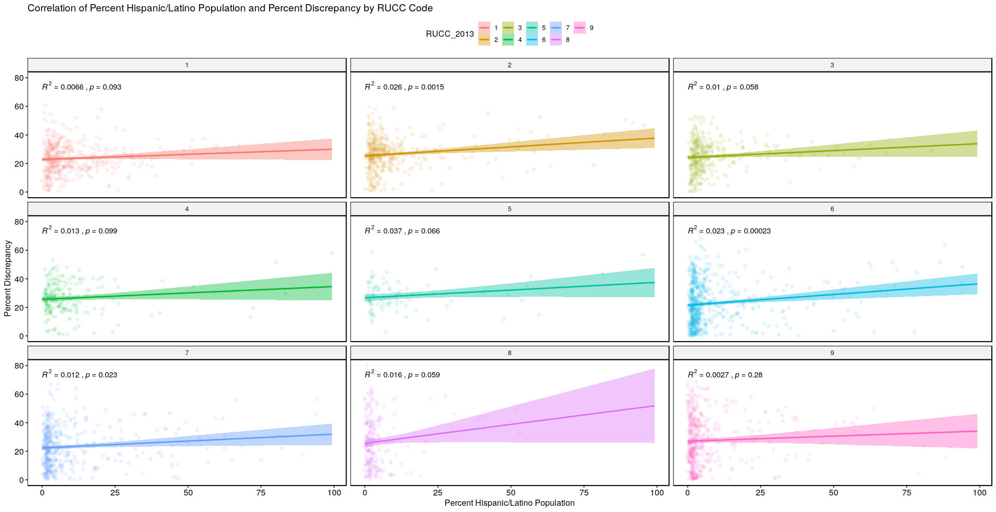
Not for poster

Slide 21
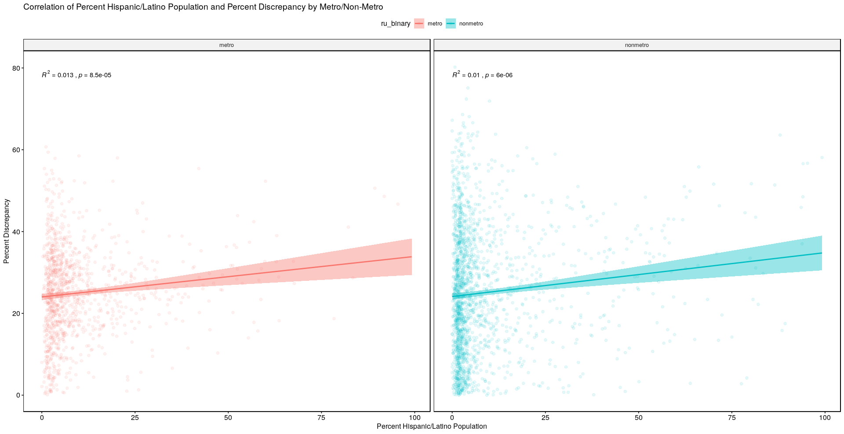
Not for poster

Slide 22
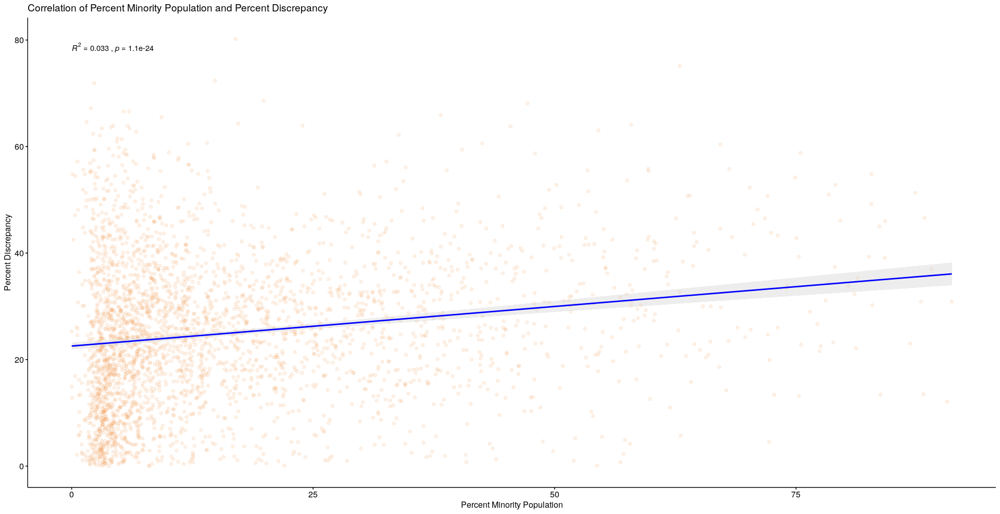
Not for poster

Slide 23
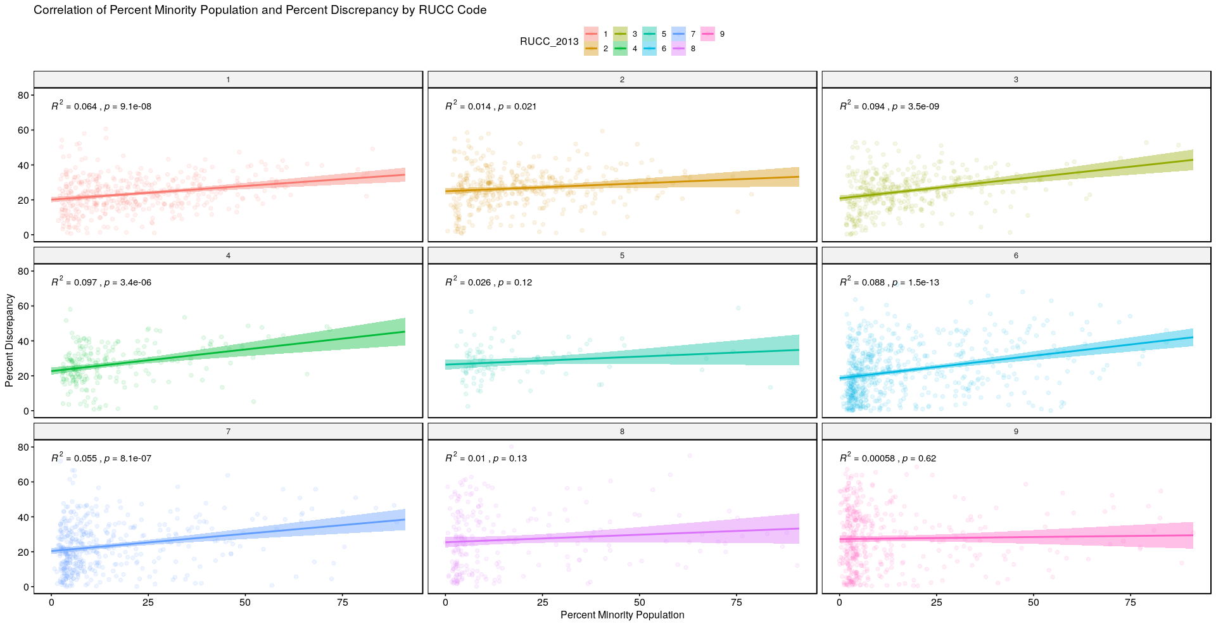
Not for poster

Slide 24
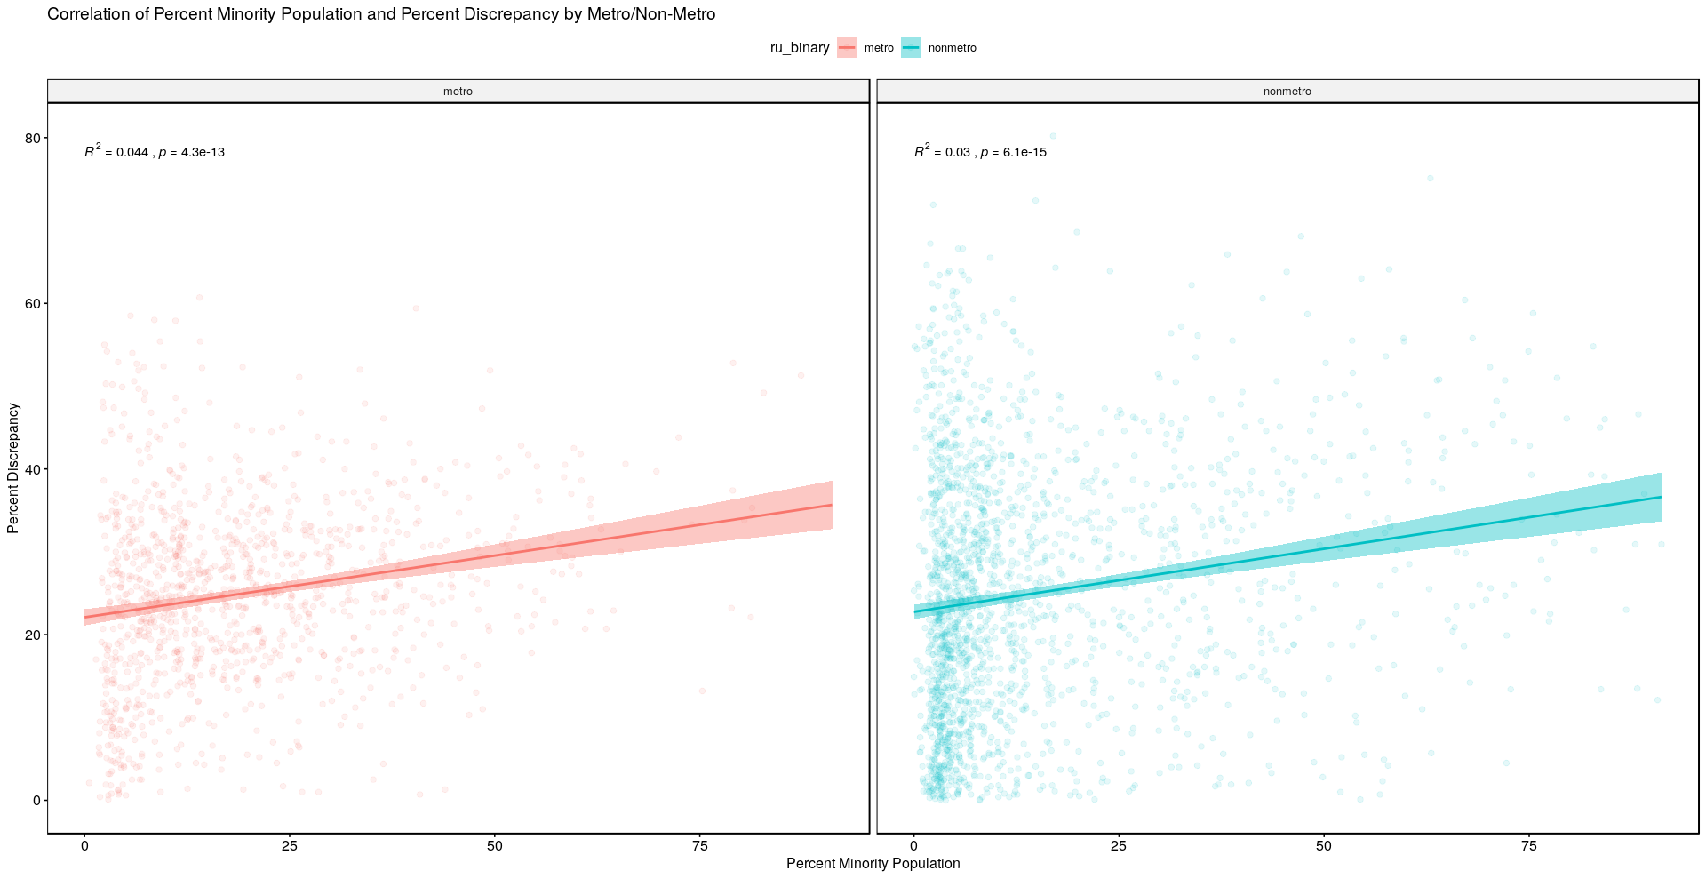
See slide 15

Slide 25
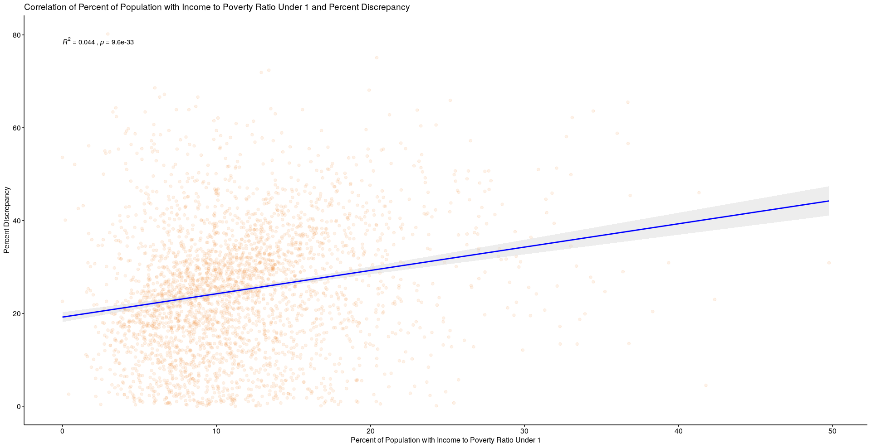
Not for poster

Slide 26
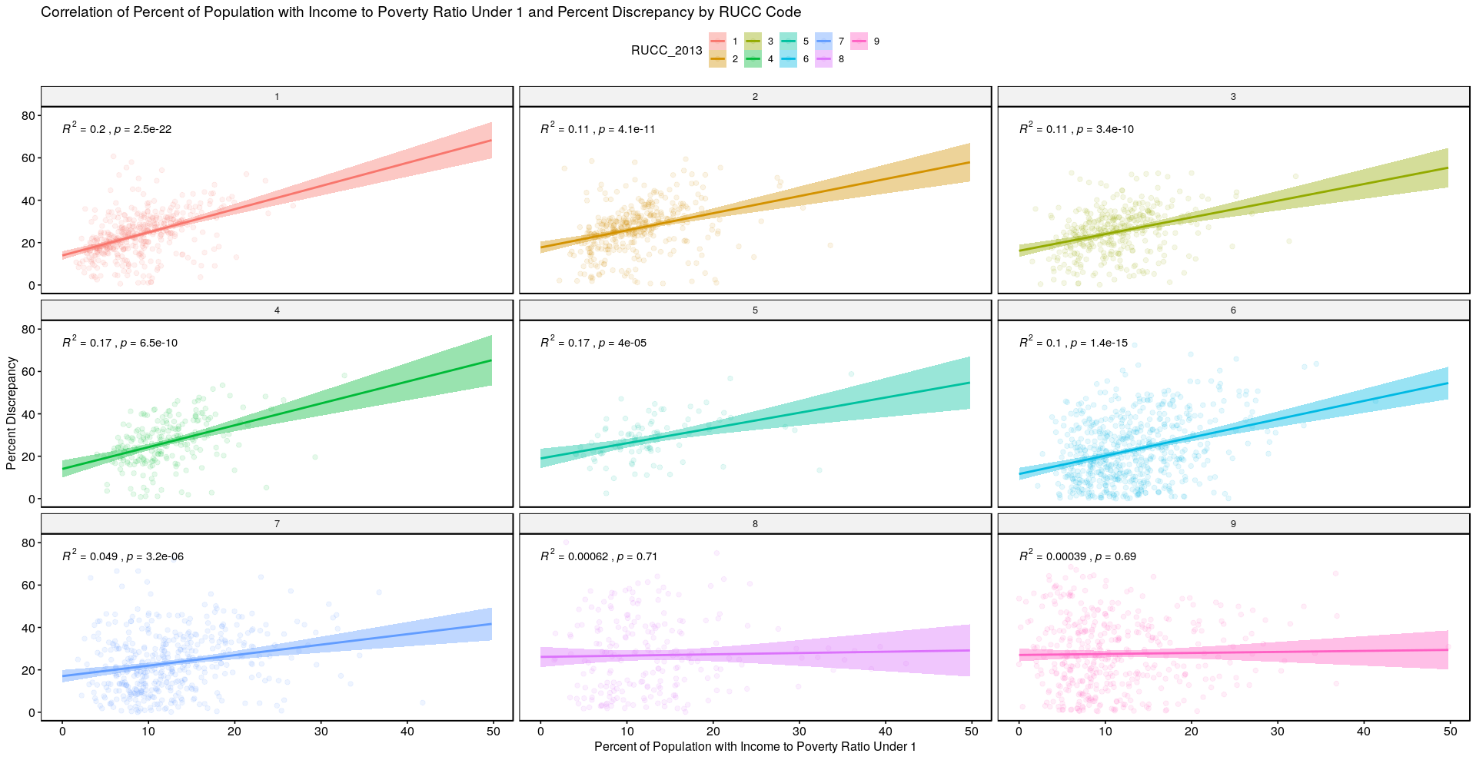
Not for poster

Slide 27
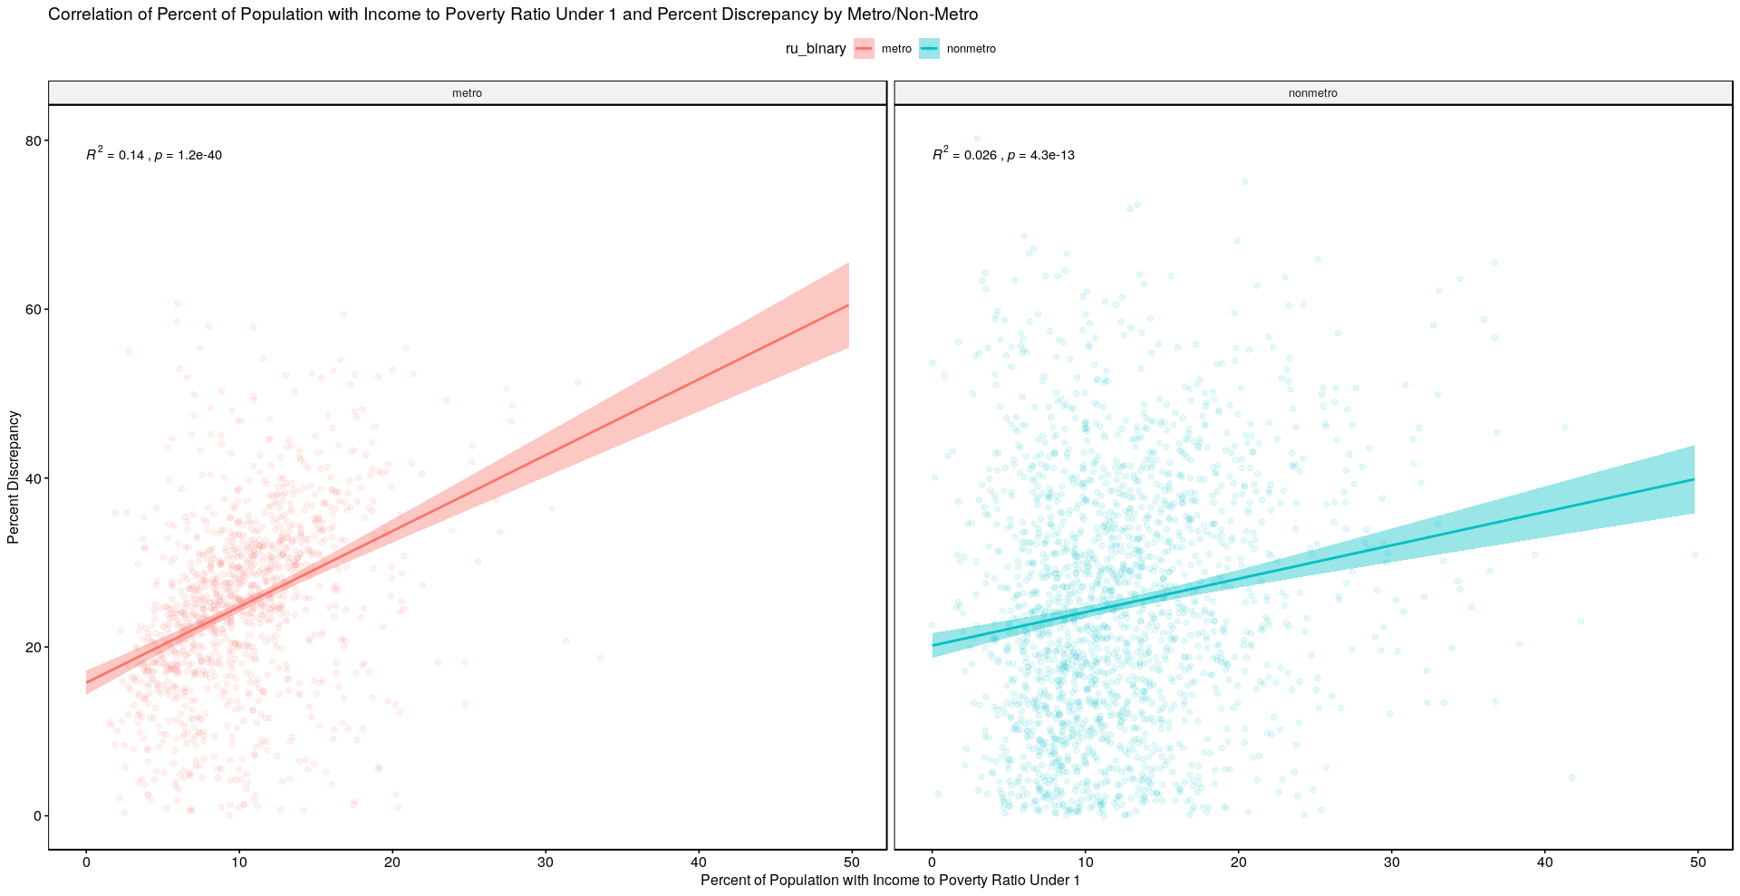
See slide 15

Slide 28
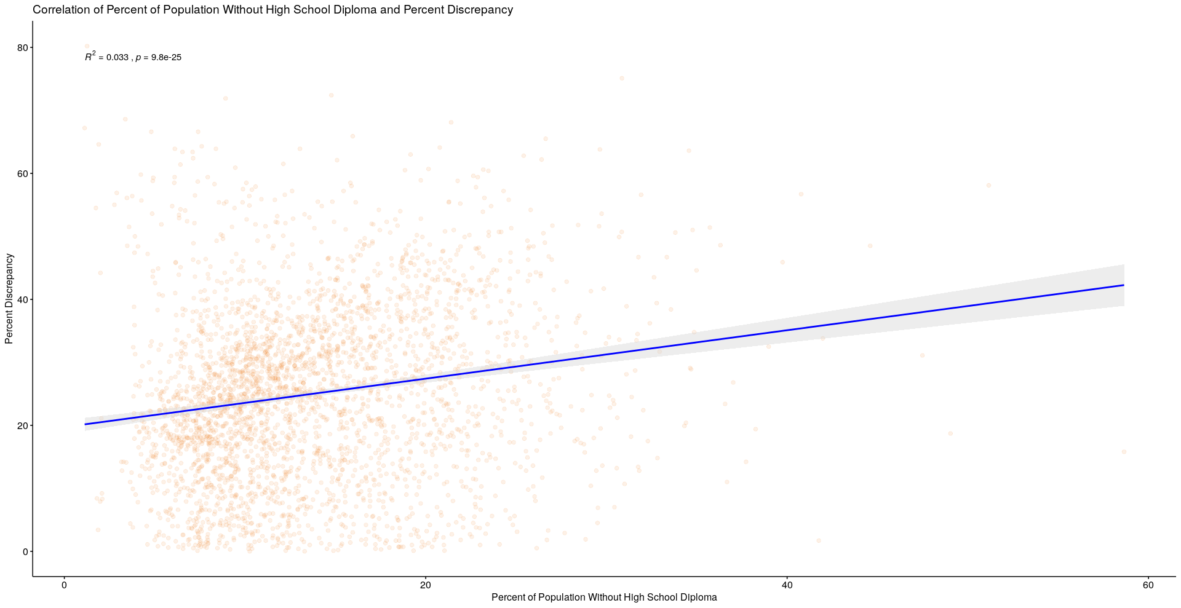
Not for poster

Slide 29
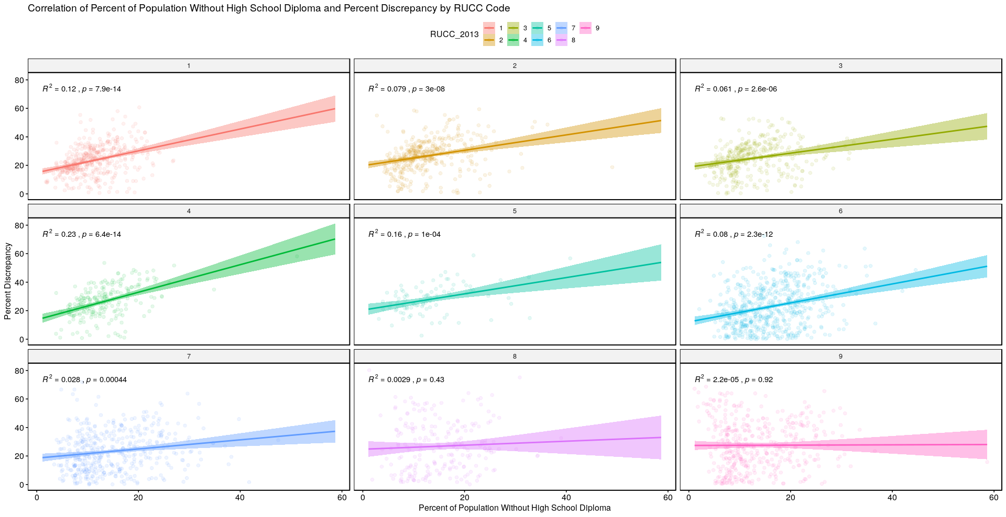
Not for poster

Slide 30
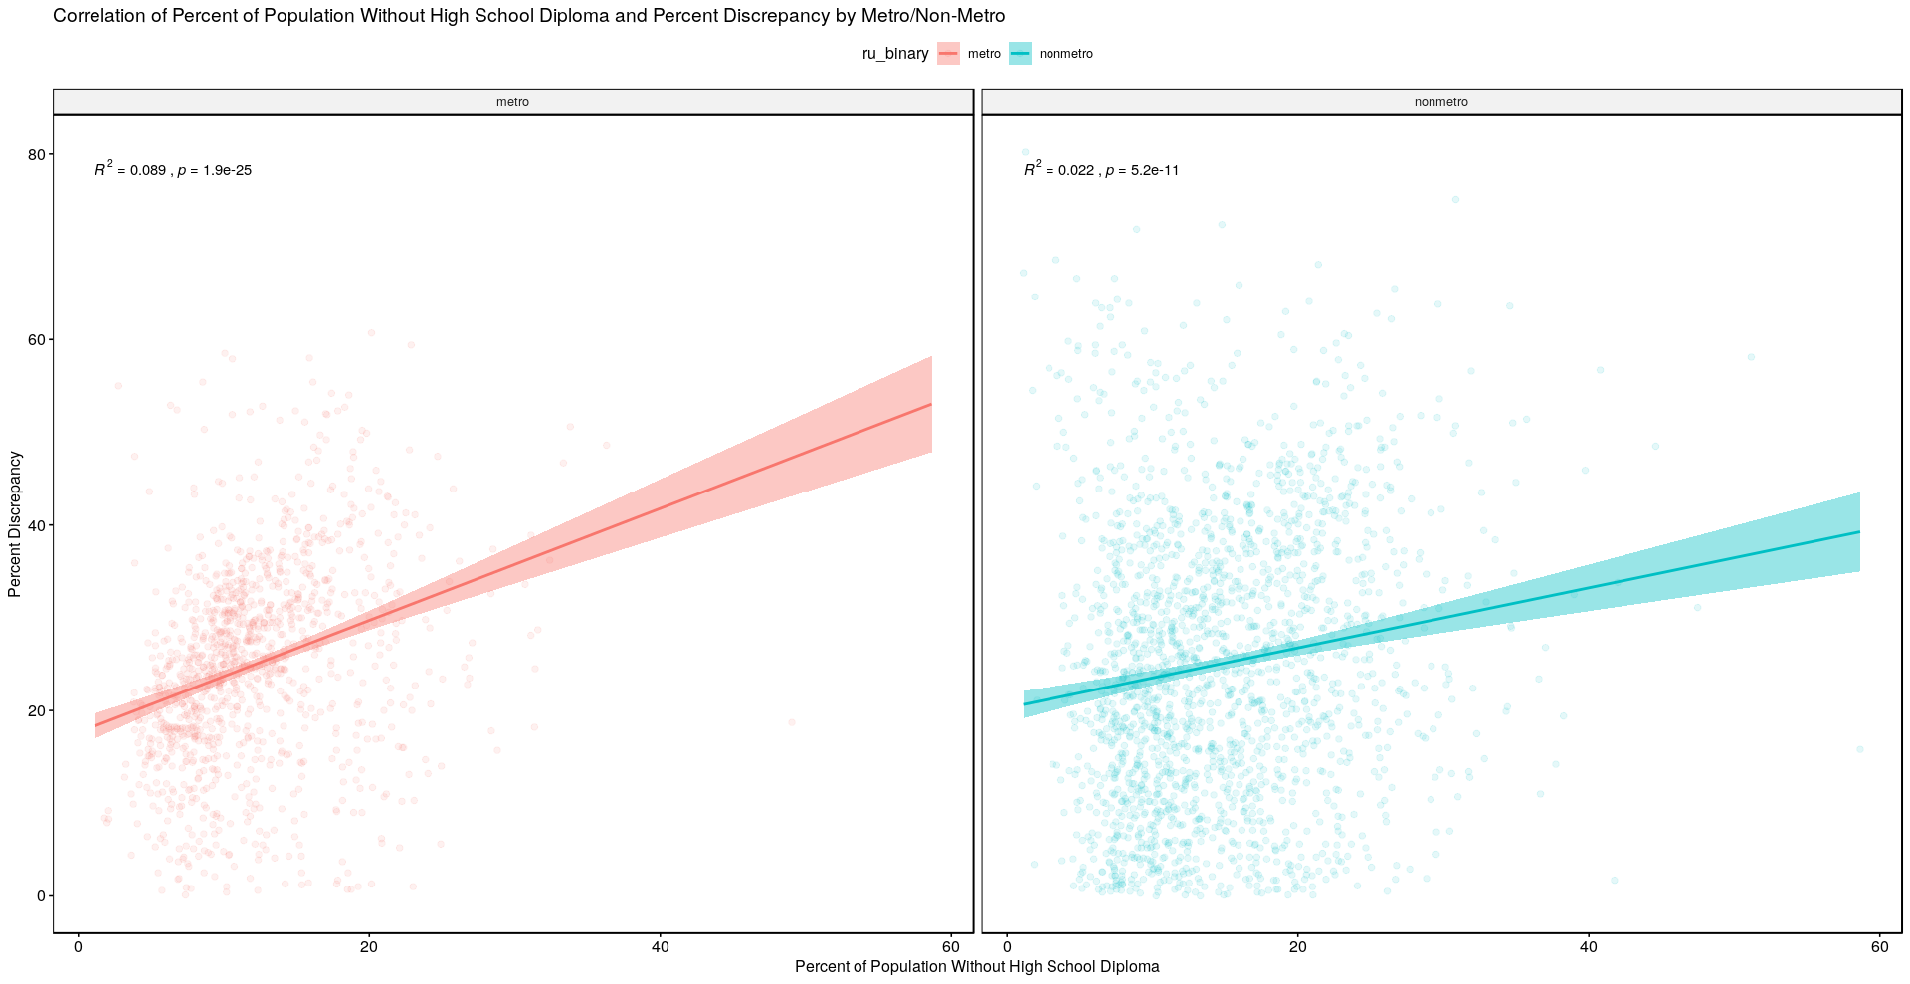
See slide 15

Slide 31
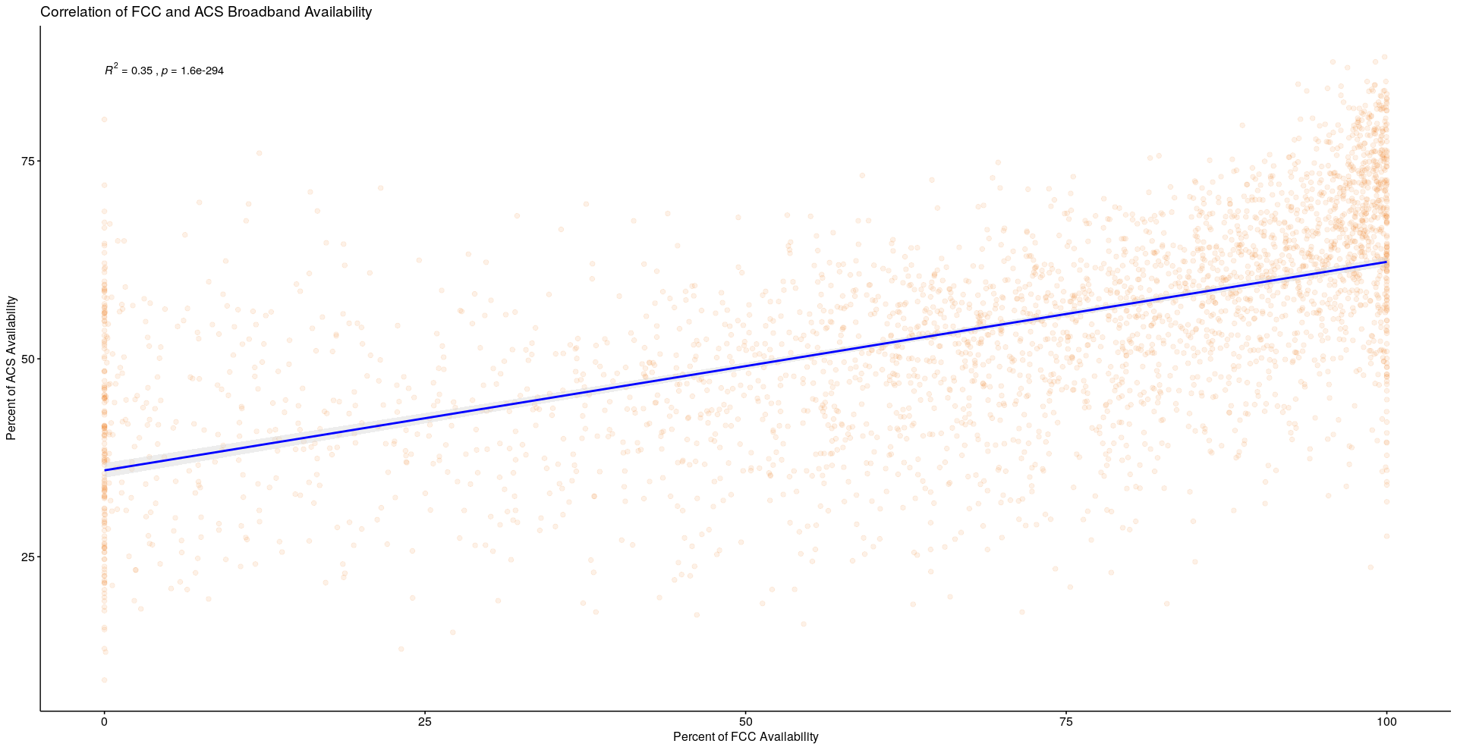
Not for poster

Slide 32
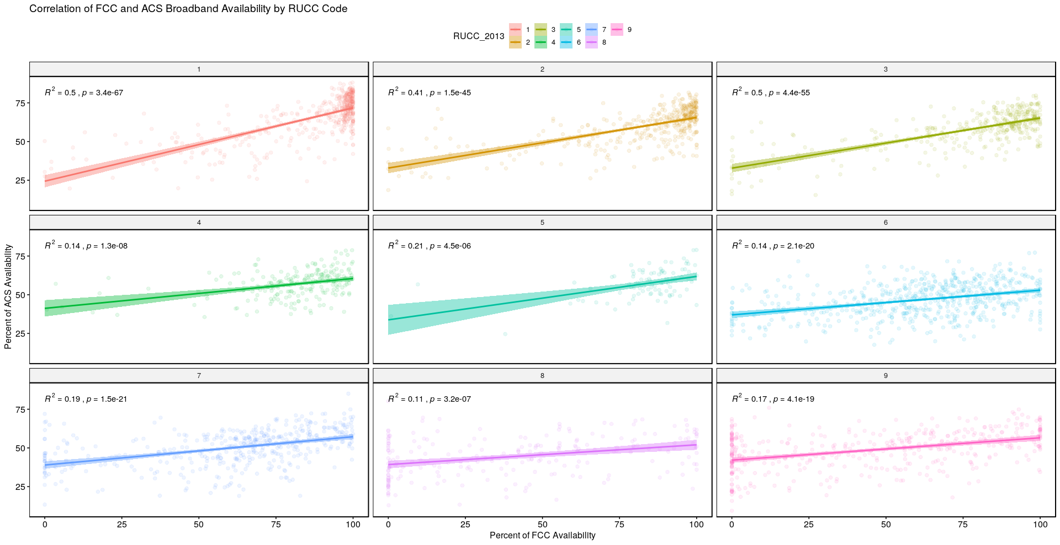
Not for poster

Slide 33
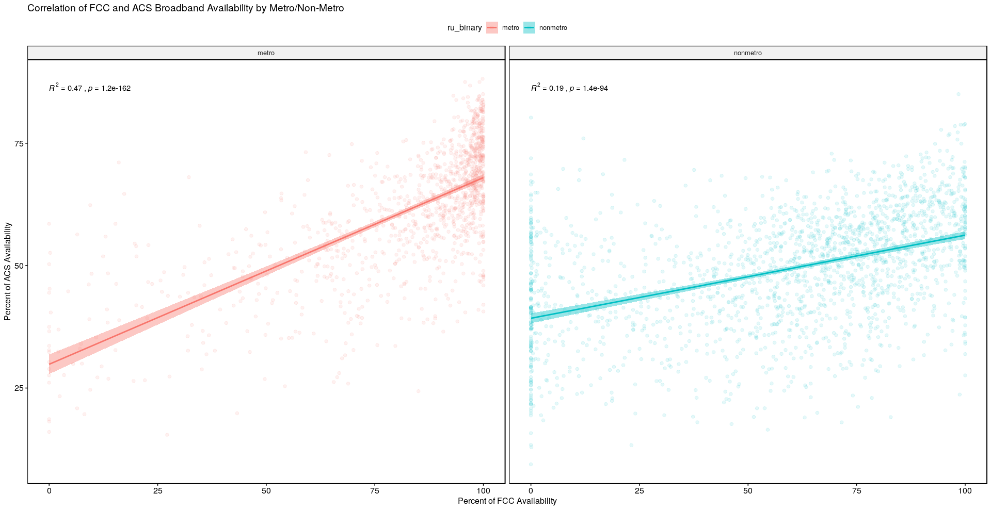
Possibly for poster but it is kind of doubling the information from slides 2,9, etc.
If we used this, I would try to come up with a way to display all three data sources together (FCC and ACS, FCC and Microsoft, Microsoft and ACS), I am just blanking right now on whether there's a good way to do it....

Slide 34
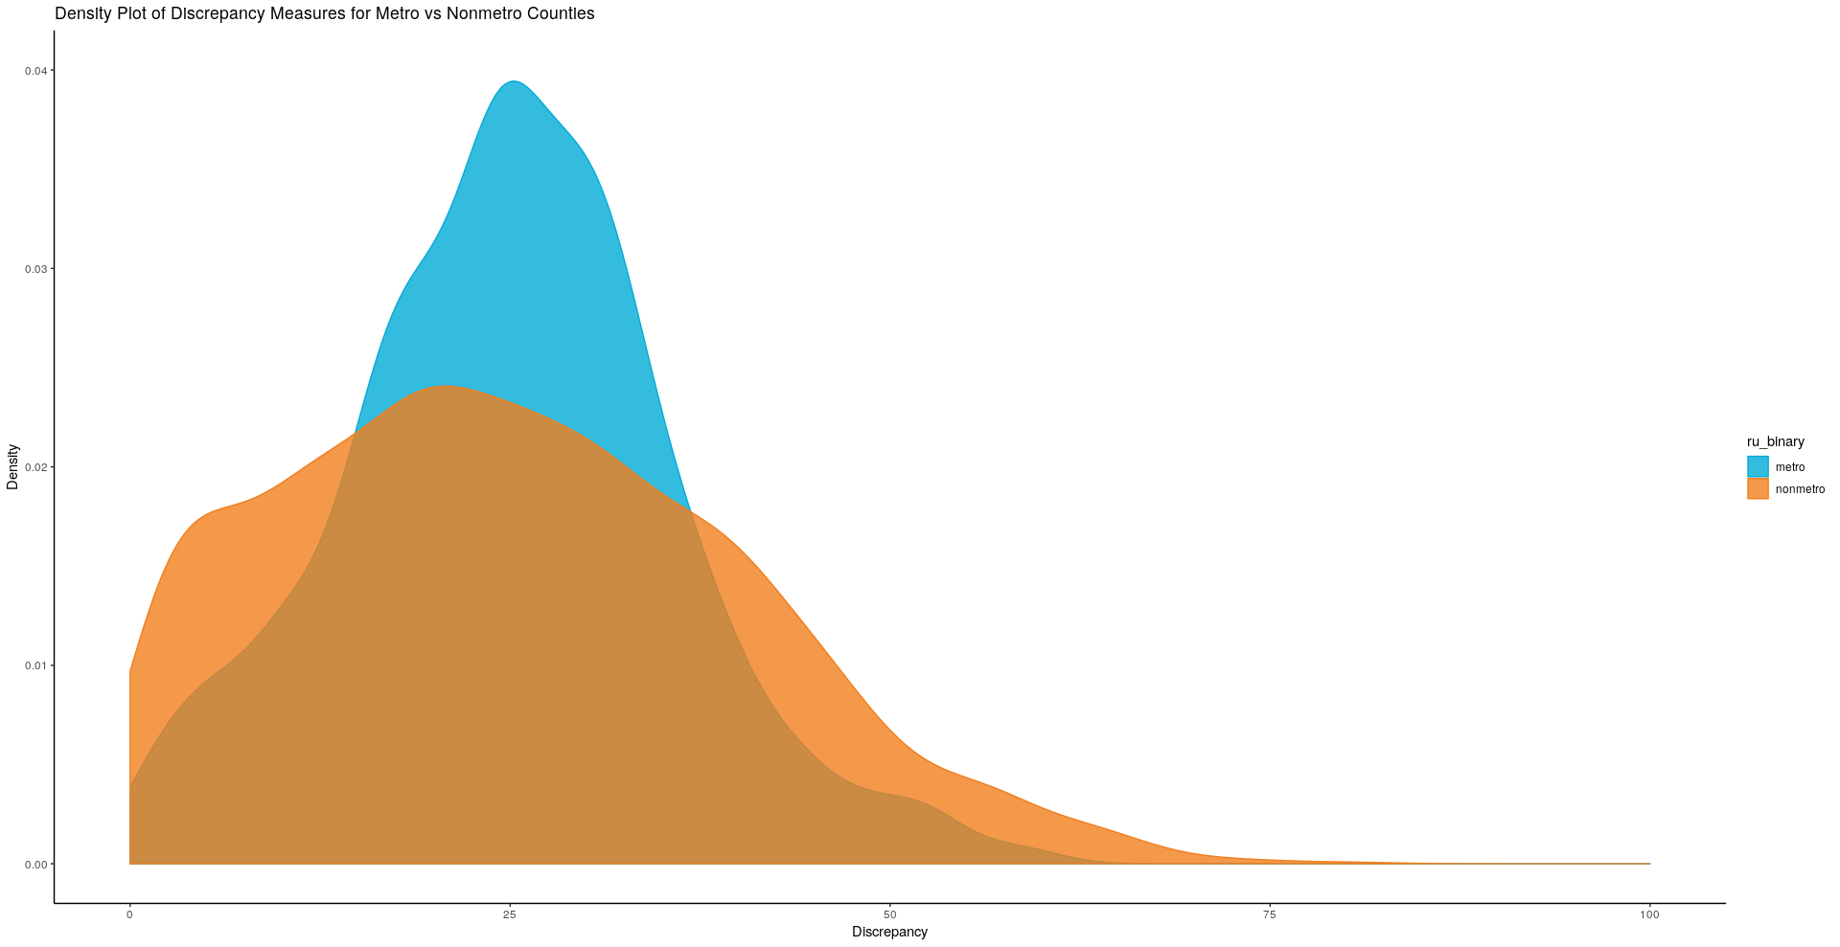
Not for poster

Slide 35
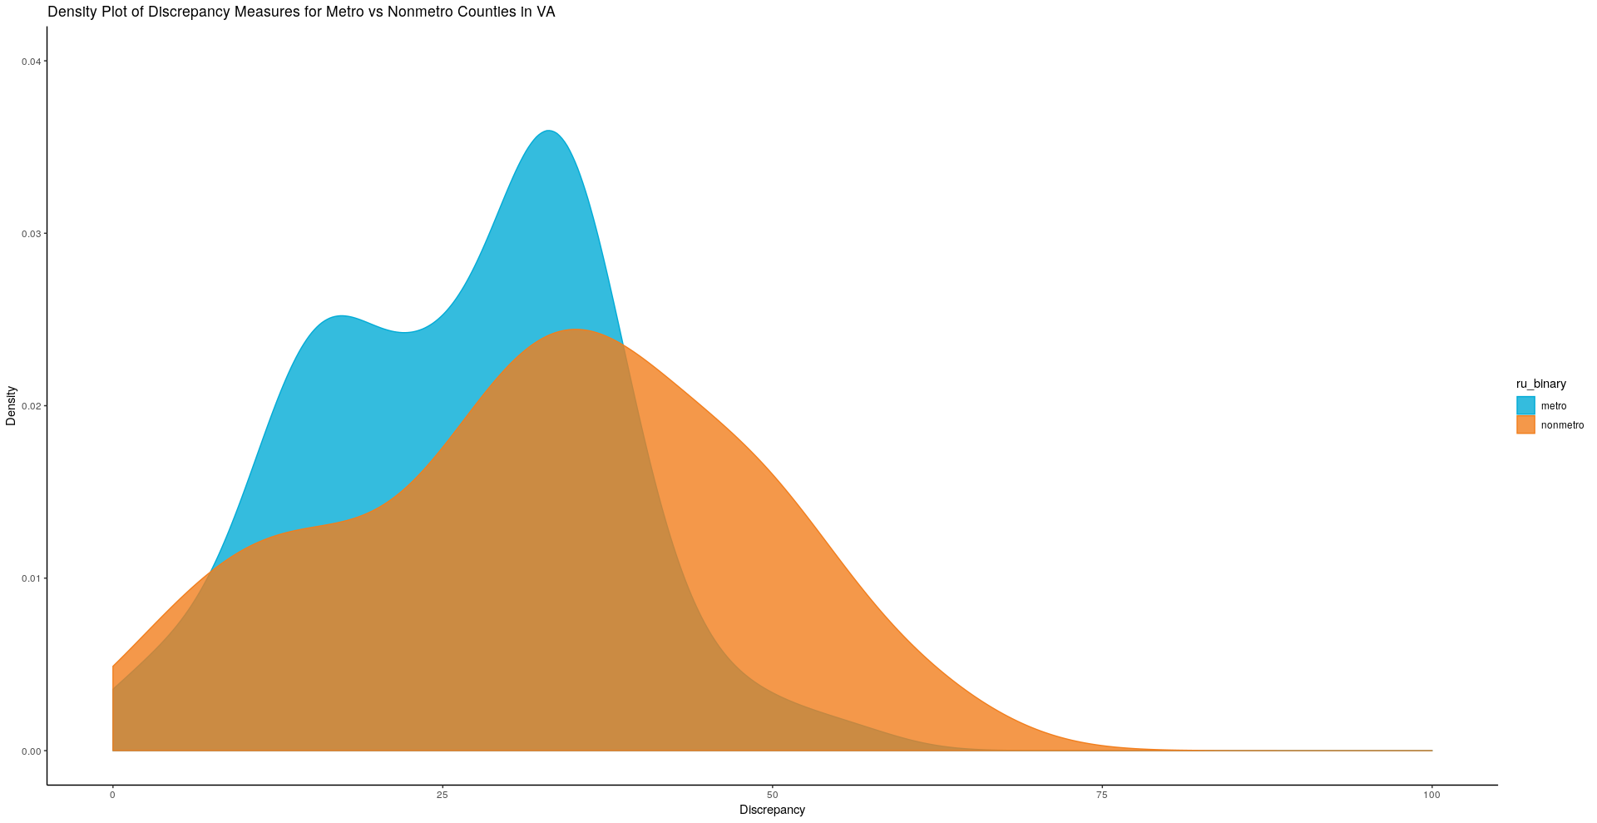
Maybe?

